Slide 1
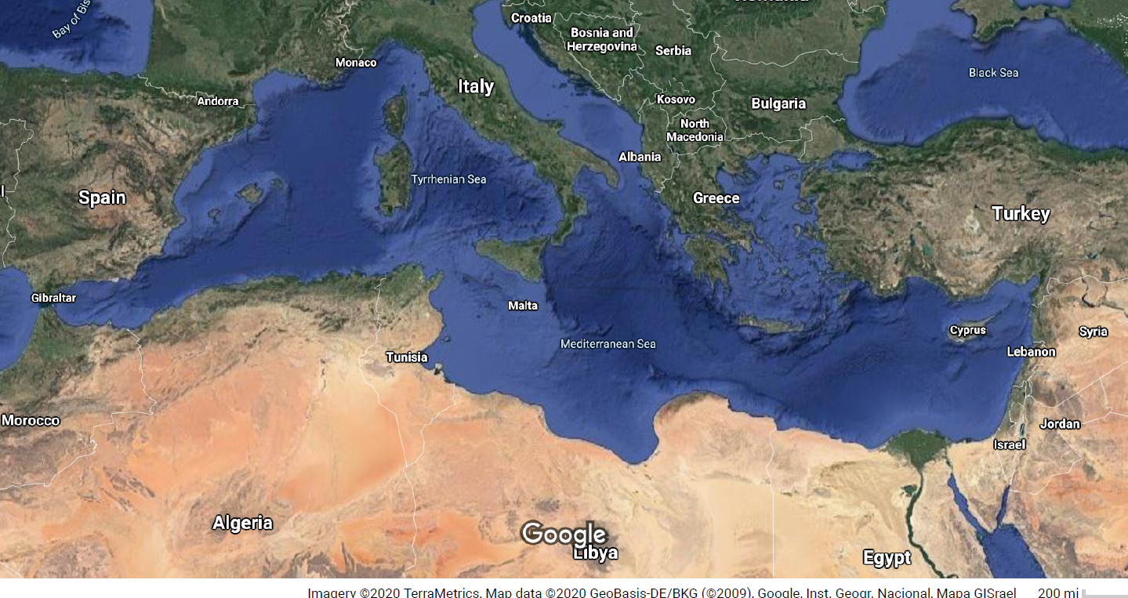

Slide 3
Greek: ἔθνος (ethnos) = “nation”
γενος (genos) = “people/tribe”
Hebrew: עם (`am) = “People”
גוי (goy) = Nation

Slide 4
Bible as specific cultural product of the ethnos of Israel

Slide 5
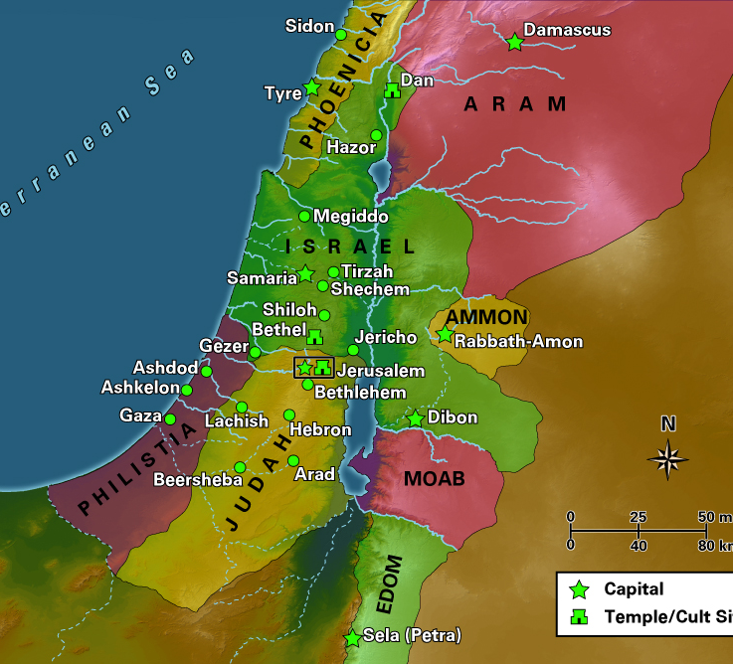

Slide 6
Israelite
Hebrew
Judean
Jewish

Slide 7
Amos 1
Thus says the Lord:
For three transgressions of Damascus,
and for four, I will not revoke the punishment;﻿…
For three transgressions of Gaza, …
For three transgressions of Tyre, …
For three transgressions of Edom, …. Ammonites…. Moab

Slide 8
Amos 1
Thus says the Lord:
For three transgressions of Damascus,
and for four, I will not revoke the punishment;﻿…
For three transgressions of Gaza, …
For three transgressions of Tyre, …
For three transgressions of Edom, …. Ammonites…. Moab

Slide 9
Ruth 1
“Then Naomi started to return with her daughters-in-law from the country of Moab…
But Ruth said,
“Do not press me to leave you
or to turn back from following you!
Where you go, I will go;
where you lodge, I will lodge;
your people shall be my people,
and your God my God.
Where you die, I will die—
there will I be buried.

Slide 10
Exclusivism in the Hebrew Bible
Exodus 34:15-16:
You shall not make a covenant with the inhabitants of the land, for when they prostitute themselves to their gods and sacrifice to their gods… you will take wives from among their daughters for your sons, and their daughters who prostitute themselves to their gods will make your sons also prostitute themselves to their gods.

Slide 11
Exclusivism in the Hebrew Bible
Ezra 10:
9 Then all the people of Judah and Benjamin assembled at Jerusalem within the three days; it was the ninth month, on the twentieth day of the month. All the people sat in the open square before the house of God, trembling because of this matter and because of the heavy rain. 10 Then Ezra the priest stood up and said to them, “You have trespassed and married foreign women, and so increased the guilt of Israel. 11 Now make confession to the Lord the God of your ancestors, and do his will; separate yourselves from the peoples of the land and from the foreign wives.”

Slide 12
Exclusivism in the Hebrew Bible
Ezra 10:
On the first day of the first month they had come to the end of all the men who had married foreign women.
18 There were found of the descendants of the priests who had married foreign women, of the descendants of Jeshua son of Jozadak and his brothers: Maaseiah, Eliezer, Jarib, and Gedaliah. 19 They pledged themselves to send away their wives, and their guilt offering was a ram of the flock for their guilt. 20 Of the descendants of Immer: Hanani and Zebadiah. 21 Of the descendants of Harim: Maaseiah, Elijah, Shemaiah, Jehiel, and Uzziah. 22 Of the descendants of Pashhur: Elioenai, Maaseiah, Ishmael, Nethanel, Jozabad, and Elasah.
23 Of the Levites: Jozabad, Shimei, Kelaiah (that is, Kelita), Pethahiah, Judah, and Eliezer. 24 Of the singers: Eliashib. Of the gatekeepers: Shallum, Telem, and Uri.
25 And of Israel: of the descendants of Parosh: Ramiah, Izziah, Malchijah, Mijamin, Eleazar, Hashabiah,﻿﻿ and Benaiah. 26 Of the descendants of Elam: Mattaniah, Zechariah, Jehiel, Abdi, Jeremoth, and Elijah. 27 Of the descendants of Zattu: Elioenai, Eliashib, Mattaniah, Jeremoth, Zabad, and Aziza. 28 Of the descendants of Bebai: Jehohanan, Hananiah, Zabbai, and Athlai. 29 Of the descendants of Bani: Meshullam, Malluch, Adaiah, Jashub, Sheal, and Jeremoth. 30 Of the descendants of Pahath-moab: Adna, Chelal, Benaiah, Maaseiah, Mattaniah, Bezalel, Binnui, and Manasseh. 31 Of the descendants of Harim: Eliezer, Isshijah, Malchijah, Shemaiah, Shimeon, 32 Benjamin, Malluch, and Shemariah. 33 Of the descendants of Hashum: Mattenai, Mattattah, Zabad, Eliphelet, Jeremai, Manasseh, and Shimei. 34 Of the descendants of Bani: Maadai, Amram, Uel, 35 Benaiah, Bedeiah, Cheluhi, 36 Vaniah, Meremoth, Eliashib, 37 Mattaniah, Mattenai, and Jaasu. 38 Of the descendants of Binnui:﻿﻿ Shimei, 39 Shelemiah, Nathan, Adaiah, 40 Machnadebai, Shashai, Sharai, 41 Azarel, Shelemiah, Shemariah, 42 Shallum, Amariah, and Joseph. 43 Of the descendants of Nebo: Jeiel, Mattithiah, Zabad, Zebina, Jaddai, Joel, and Benaiah. 44 All these had married foreign women, and they sent them away with their children.﻿﻿

Slide 13
Inclusivism in the Hebrew Bible
Exodus 12:48
If an alien who resides with you wants to celebrate the passover to the Lord, all his males shall be circumcised; then he may draw near to celebrate it; he shall be regarded as a native of the land. But no uncircumcised person shall eat of it;

Slide 14
Inclusivism in the Hebrew Bible
Gen 23:4 “I am a stranger and an alien residing among you; give me property among you for a burying place, so that I may bury my dead out of my sight.

Slide 15
Inclusivism in the Hebrew Bible
Deut 10
14 Although heaven and the heaven of heavens belong to the Lord your God, the earth with all that is in it, 15 yet the Lord set his heart in love on your ancestors alone and chose you, their descendants after them, out of all the peoples, as it is today. 16 Circumcise, then, the foreskin of your heart, and do not be stubborn any longer. 17 For the Lord your God is God of gods and Lord of lords, the great God, mighty and awesome, who is not partial and takes no bribe, 18 who executes justice for the orphan and the widow, and who loves the strangers, providing them food and clothing. 19 You shall also love the stranger, for you were strangers in the land of Egypt.

Slide 16
Inclusivism in the Hebrew Bible
Lev 19
When an alien resides with you in your land, you shall not oppress the alien. 34 The alien who resides with you shall be to you as the citizen among you; you shall love the alien as yourself, for you were aliens in the land of Egypt: I am the Lord your God.

Slide 17
Inclusivism in the Hebrew Bible
Deuteronomy 27:19
19 “Cursed be anyone who deprives the alien, the orphan, and the widow of justice.” All the people shall say, “Amen!”

Slide 18
Inclusivism in the Hebrew Bible
Psalm 146:9
The LORD watches over the strangers; he upholds the orphan and the widow, but the way of the wicked he brings to ruin.

Slide 19
Inclusivism in the Hebrew Bible
Jeremiah 7
3 Thus says the Lord of hosts, the God of Israel: Amend your ways and your doings, and let me dwell with you﻿﻿ in this place. 4 Do not trust in these deceptive words: “This is﻿﻿ the temple of the Lord, the temple of the Lord, the temple of the Lord.”
5 For if you truly amend your ways and your doings, if you truly act justly one with another, 6 if you do not oppress the alien, the orphan, and the widow, or shed innocent blood in this place, and if you do not go after other gods to your own hurt, 7 then I will dwell with you in this place, in the land that I gave of old to your ancestors forever and ever.

Slide 20
Inclusivism in the Hebrew Bible
Zech 7
Thus says the LORD of hosts: Render true judgments, show kindness and mercy to one another; do not oppress the widow, the orphan, the alien, or the poor; and do not devise evil in your hearts against one another.

Slide 21
Inclusivism in the Hebrew Bible
Ezekiel 27
21 So you shall divide this land among you according to the tribes of Israel. 22 You shall allot it as an inheritance for yourselves and for the aliens who reside among you and have begotten children among you. They shall be to you as citizens of Israel; with you they shall be allotted an inheritance among the tribes of Israel. 23 In whatever tribe aliens reside, there you shall assign them their inheritance, says the Lord God.

Slide 22
Ethnoracial Identity in Antiquity
Ethnic and Racial Identity in premodern groups:
  Anthony Smith (sociologist)
    o Named human populations
    o Shared ancestry
    o Shared myths, histories, and cultures
    o An association with a specific territory
    o Sense of solidarity
  Identity is transmitted through sacred texts, myths, memories, values, and symbols.
    Meanings change over time

Slide 23
Israelite Identity
Kinship
Conflict
Customs
Land?
Torah-ordered worship of YHWH
Religious “conversion” to worship of Israel’s God are a change in ethnicity

